Slide 1
Monte Carlo Simulation Duel in a game background
Game Engine: Dota2 (Dota2 based RPG)
Map Name: Battle of Mirkwood
Group Member:
Bill Ho Nam Wong
Beihua Wang
Notes:
Hi everyone, our project is type II project, Monte Carlo Simulation for a duel in a Dota2 based Role Play Game. The game is called Battle of Mirkwood.

Slide 2
Introduction
Game Mechanism
Basic Assumption
Variables
Notes:
In introduction part, we will introduce the Game Mechanism, our basic assumptions, the variables in our model.

Slide 3
Game Mechanism
Player gets a randomly chosen hero
Hundreds of neutral monsters wandering throughout the map, killing monsters will grant Gold, Exp and different Skill Books
Skill Book: can grant hero a skill, skill max level: 10
E.g., Consuming skill book: Life Steal will grant hero the skill Life Steal. Consuming skill book Life Steal again will improve the skill level to level 2.
When encounter another player, a duel might happen
The player who first gets 80 kills wins the game
Notes:
In this RPG game, all the players will gets a randomly chosen hero. Different hero has different attributes like Hit Point, Armor, Attack Speed, Damage and so on.
During the game, hundreds of neutral monsters wandering through the map. Kill the monsters will grant player Gold, Exp and Skill Books.
Different skill books will grant hero different skills. Consuming same skill book again will improve the skill level. For example, consuming skill book Evasion at first time will let the hero learn the skill Evasion. Consuming same book again will improve the skill level of Evasion to two. Max skill level is 10 and a hero can at most learn 4 such skills.
Except neutral monsters, a player might encounter another player, this is when duel happens.
The player who gets 80 kills first win the game.
Due to time concern, many other details are omitted here, if you are interested, you can view our proposal document.

Slide 4
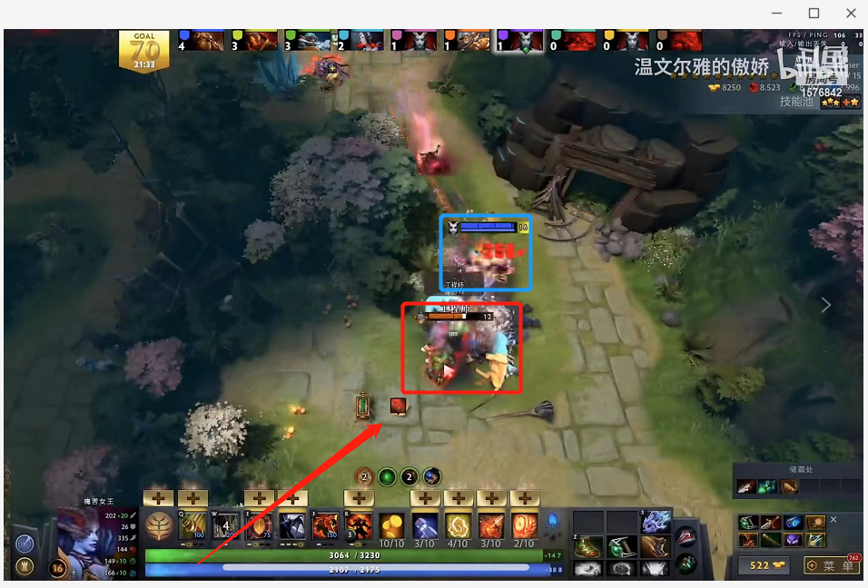
Game Mechanism
Notes:
In this RPG game, all the players will gets a randomly chosen hero. Different hero has different attributes like Hit Point, Armor, Attack Speed, Damage and so on.
During the game, hundreds of neutral monsters wandering through the map. Kill the monsters will grant player Gold, Exp and Skill Books.
Different skill books will grant hero different skills. Consuming same skill book again will improve the skill level. For example, consuming skill book Evasion at first time will let the hero learn the skill Evasion. Consuming same book again will improve the skill level of Evasion to two. Max skill level is 10 and a hero can at most learn 4 such skills.
Except neutral monsters, a player might encounter another player, this is when duel happens.
The player who gets 80 kills first win the game.
Due to time concern, many other details are omitted here, if you are interested, you can view our proposal document.

Slide 5
Basic Assumption
There are two ways to play the game:
Spell-Based: The players learned a lot of Spells, kill other players by casting spells.
Attack-Based: The player learned a lot of Passive Skills, kill other players by Attack.
We assume all the players are Attack-Based.
We assume all the players equip same items.
We assume the player got similar Exp and same amount of Skill Books.
Notes:
Here is our assumptions.
Basically, there are two different directions in the game. One is to cast spells to kill other players, another way is to learn a lot of passive skills like Critical and kill enemies by attack.
We assume all the players play the game in the second way.
Second, we assume all the players equip same items.
Third, we assume the players got similar Exp and same amount of skill books. Which means, the hero level will be the same.

Slide 6
Basic Assumption
Assume when the players encounter each other, HP is at Max HP. (Usually not true in stage1 but is always true beyond stage1.)
When a Duel happens, there will not be a third player.
Due Stage: (Phase)
Phase1 | Level 6 | Each side will randomly be given one main skills and randomly given 20 Skill Books.
Phase2 | Level 15 | Each side will randomly be given two main skills and randomly given 60 Skill Books. Each side has Monkey King Bar and Heart of Tarrasque equipped.
Notes:
Further, we assume when a player encounter another player, both of the two sides’ current HP is at max HP.
And when a duel happens, there will not be a third party.
Duel might happen at any time during the game, we roughly divides it to few phases. In different phases, the hero level and the items will be different. But in same phase, the players will get same hero level and have same items

Slide 7
Skill Name | Effect | Math (Max Level: 10)
Attribute Bonus | Gain extra Strength, Agility, and Intelligence | 5*(Skill Level)
Evasion | Grant hero the ability to evade enemy attack. | 30 + 5*(Skill Level)
Corruption | Reduce enemy armor | 2*(Skill Level)
Armor Bonus | Gain extra Armor | 5 + 2*(Skill Level)
Thorn Armor (Physical) | Gain extra Armor and cause damage to enemy when was hit | Armor: 1*(Skill Level) Damage: 5*(Skill Level)
Curse of Death (True Damage) | Deal damage to surrounding enemy by second. Reducing enemy regeneration by percent. | Damage:10/20/30/40/60/80/100/120/150/200 Regeneration reduction: 20 + 5*(Skill Level)
Fire! | Ignore enemy armor when deal physical damage | 10 + 5*(Skill Level)
Smash (Physical) | Grants each attack a 20% chance to deal extra magic damage. | Basic Damage: 80 + 20*(Skill Level) Attached Damage: 1%*(Skill Level) of Enemy Max HP
Damage Bonus | Gain extra damage | 30 + 25*(Skill Level)
Life Steal | Grants each attack an 30% chance to regenerate HP by the damage that attack causes. | 20 + 5*(Skill Level)
Crushing (True Damage) | Grants each attack an 15% chance to deal extra true damage. | Damage: 50 + 50*(Skill Level) Attached Damage: 0.5* Strength*(Skill Level)
Notes:
Here is the list of sub Skills. We set 11 sub skills in our model.
The Skill Evasion will grant the hero ability to evade enemy attack. You can find the Evasion possibility is very high, thus, we introduced an item called Monkey King Bar, or MKB, to our model. When equips MKB, the Hero will have an 80% chance to ignore enemy’s evasion skills.
The skill smash will grant each attack a 20% chance to deal extra magic damage. The amount of damage is shown in the column Math.

Slide 8
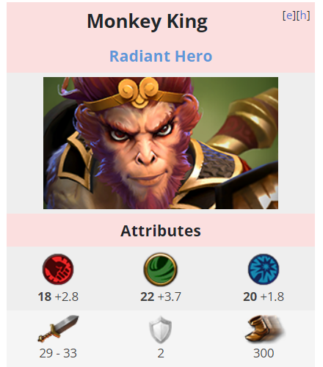
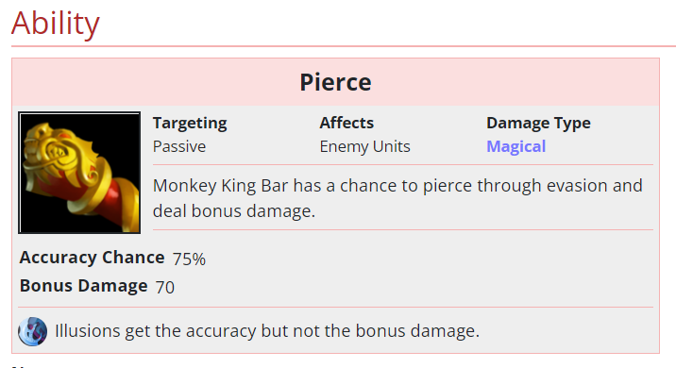
Skill Name | Effect | Math (Max Level: 10)
Smash (Physical) | Grants each attack a 20% chance to deal extra magic damage. | Basic Damage: 80 + 20*(Skill Level) Attached Damage: 1%*(Skill Level) of Enemy Max HP
Evasion | Grant hero the ability to evade enemy attack. | 30 + 5*(Skill Level)
Notes:
Here is the list of sub Skills. We set 11 sub skills in our model.
The Skill Evasion will grant the hero ability to evade enemy attack. You can find the Evasion possibility is very high, thus, we introduced an item called Monkey King Bar, or MKB, to our model. When equips MKB, the Hero will have an 80% chance to ignore enemy’s evasion skills.
The skill smash will grant each attack a 20% chance to deal extra magic damage. The amount of damage is shown in the column Math.

Slide 9
Variables
Fixed Variables:
Attributes of Hero are set by Dota2
Armor, Hit Point, etc.
Items: the Attributes of each Item are set by Dota2
Skill Effects: the Attributes of Skills at particular level will not change
Controlled Variables:
Items: The hero will equip which Item
Hero Level
Total Amount of Skill Books
Notes:
The fixed variables include hero models, items and Skill effects. The attributes for each hero and each item are set by Dota2. The effect of skills is set according to the RPG game as shown on last slide.
The controlled variables is related to what phase we are. It includes hero level, total amount of skill books and what items the hero will equip by that time.

Slide 10
Variables
Example:
[2, 5, 2, 3, 0 ,1, 2, 2, 2, 1, 2]
Learn Level5, Level3 skill Randomly pick two Level2 Skills
Variables with Randomness
What combination of Skill Books the player will get is randomly decided, it means:
What Skill the player will learn
The Skill Level is also randomly decided
When attack, the damage of hero has a range E.g., Monkey King damage at level1: 51~55
Most skills will let the attack hero deal extra damage to that hit; Whether or not the skill effect is triggered is randomly decided.
What main skill the players will get
Notes:
The variable with randomness includes following.
What combination of skill books the hero will get is randomly decided. The hero will learn the top 4 level skills.
For example, the player rolled 20 skill books and get a combination as shown in the example, he will learn that level 5 skill, that level 3 skill and randomly pick two Level 2 skills
When attack, some of the skills are triggered randomly.
For example, the skill smash, shown in skill list, only has 20% possibility to be triggered in each attack.
Besides, the damage of each hero has a small range. For example, the hero Monkey King’s damage at Level 1 is from 51 to 55.

Slide 11
Coding
Class
Main Function

Slide 12
Class and Functions
Father Class: Hero
Each Hero Model is a child class of Hero
Including: Monkey King, Life Stealer, Bounty Hunter etc.
Class Function:
Learn Skills
Set Fixed Attributes (Level, etc.)
Equip/Unequip Items
Calculate Hero Status
Take Damage & Debuff
Notes:
Hero is the father class; each Hero Model is a child class of Hero.Class Hero has various class methods; it can roughly be divided in to five types. Methods Related to learning skillsMethods Related to Fixed Attributes like Hero Level and so onMethods Related to Equipping or Unequipping Items.After the three steps above, the attributes of a hero is finally set and here comes the fourth kind of methods: calculating Hero status. For example, the eventual armor, attack speed and so on. The last kind of methods are used to cope with the damage and debuff the Hero takes during the duel.

Slide 13
Main Function:
Initialize Hero_1, Hero_2, Setting Status (Items, Level, etc.)
Simulation Loop of 1000
Roll Skill Books (Randomness)
Duel(Hero_1, Hero_2)
Long-lasting Skills take effect (Armor Corruption etc.)
While True: Attack(Hero_1, Hero_2)
Un-evadable Damage (Smash etc.) (Randomness)
The Attack missed target? (Randomness)
Attack Damage and Attack Attachment Damage (Randomness)
Reflected Damage to Attacker
Damage Calculate
If one side HP <= 0
Break
Notes:
When we call the main function. It initialize two Hero Objects, and their level, skill book amount and items as we input.
And call a function to calculate their attributes based on basic attributes, growth attributes, and extra attributes from items and skills.
Then it starts to simulate for a thousand times, it roll skill books for two heroes first, and each hero will randomly learn different skills with random skill levels.
After that, two heroes start duel and keep attacking other, attack speed will decide their attacks order and attack frequency.
For each attack, their base damage is random within range, and because of the skill effects and their probability, they have chance to deal extra damage, critical damage
or steal Hit point, the defend hero may evade, counterattack or reflect damage, some skills also deal damage per second, and the program calculates the damage based on the time difference between attacks. After considering all the situations and health regenerate per second, it will calculate the final damage and recovery, deduct or add Hit point for each hero,
If the hit point of one hero is less than 0, we will get the winner in this loop.

Slide 14
Result Analysis

Slide 15
Hypothesis
1. Evasion is the strongest sub skill
2. If heroes equip the item "MKB", the winning rate of Evasion will decrease greatly
3. Duel at different stages, the weight of skills will vary
Notes:
Here are our three hypotheses, we believe the Evasion is the best sub skill, and the Monkey king bar has an eighty percent chance to pierce through Evasion, so it will make the wining rate of Evasion decrease greatly.

Slide 16
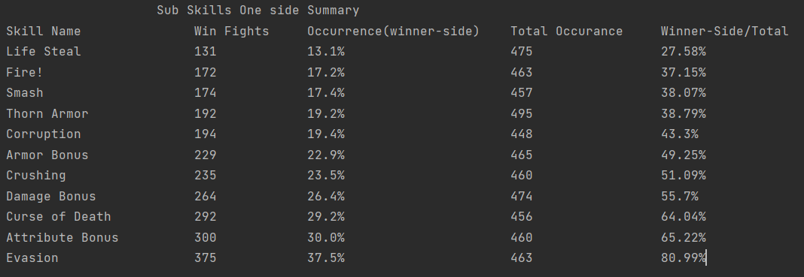
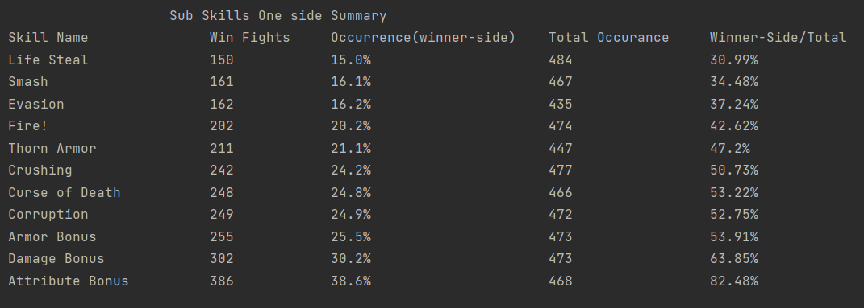
Hypothesis 1 & 2 Evasion is the strongest sub skill

Slide 17
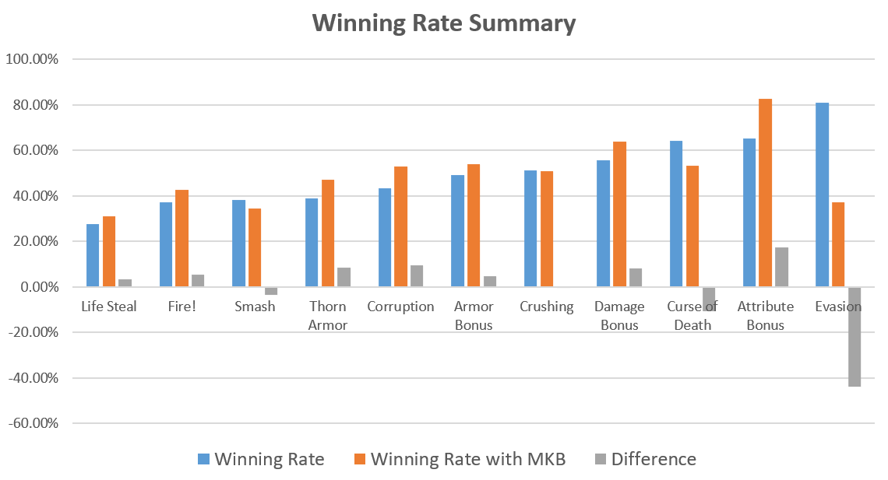
Hypothesis 1 & 2 The winning rate of Evasion will decrease greatly with "MKB"

Slide 18
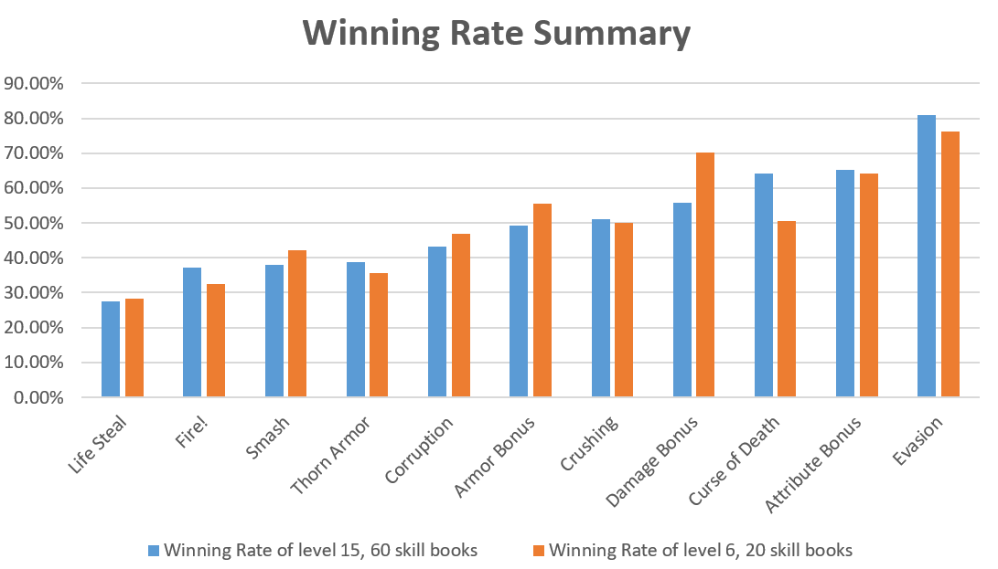
Hypothesis 3

Slide 19
Future work
Realize the Spell Skills
Analysis for the Randomness of Hero Model
It has already been realized now, but this will make analysis much more complicated.
Consider attack point time when triggering stun skills
Notes:
Our model doesn’t consider spell skills now, thus a future direction might be realization of spell skills in our model.
Although we have implement several Hero models, but we still not let the program randomly pick the hero models and finish the analysis
And about skills with stun effect, we should consider the situation that stun happens at the attack point.

